Slide 1
2014 April
General Conference

Slide 2
Conference
Scripture Mastery
Stories that Teach
Humor
Doctrines
Grab Bag
100 | 100 | 100 | 100 | 100
200 | 200 | 200 | 200 | 200
300 | 300 | 300 | 300 | 300
400 | 400 | 400 | 400 | 400
500 | 500 | 500 | 500 | 500
600 | 600 | 600 | 600 | 600
Final Jeopardy

Slide 3
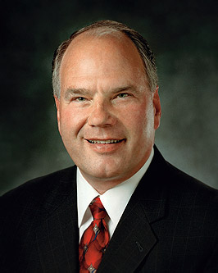
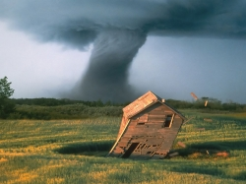
Scripture Mastery for 100
Elder Rasband told of the terrible tornadoes that hit Oklahoma; and how so many came to serve those who had been affected. He quoted this scripture about how when we serve our fellow man, we serve God.

Slide 4
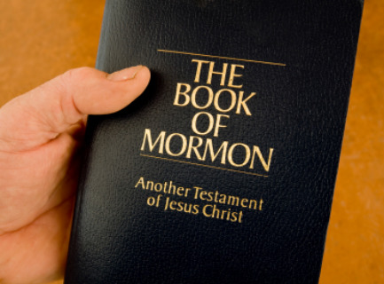
Scripture Mastery for 100
What is Mosiah 2:17?
Back

Slide 5
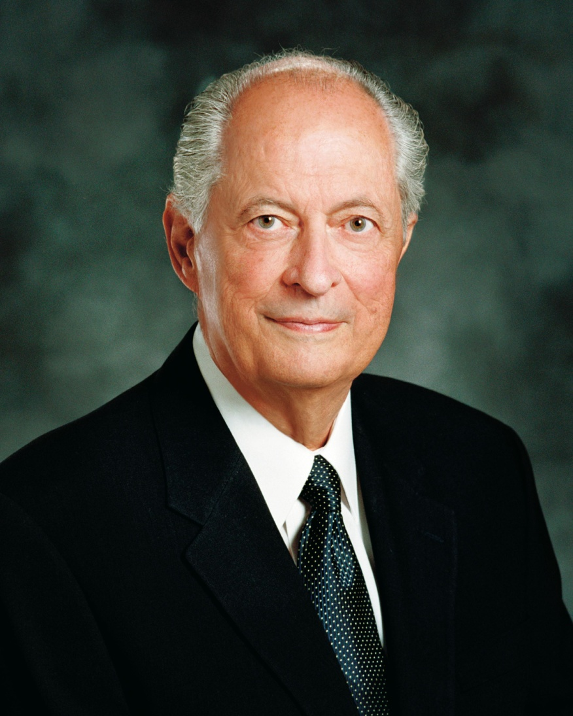
Scripture Mastery for 200
Elder Hales spoke on obedience. He quoted this SM that says, “Learn wisdom in thy youth; yea, learn in thy youth to keep the commandments of God.”

Slide 6
Scripture Mastery for 200
Answer: What is Alma 37:35?
Back

Slide 7
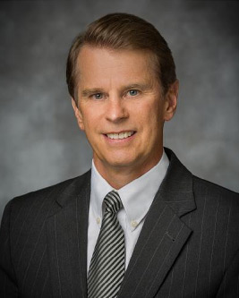
Scripture Mastery for 300
Brother Ridd spoke of the dangers of the internet. He taught that owning a smart phone doesn’t make us smart. He admonished us to watch our thoughts, our words, and our deeds.

Slide 8
Scripture Mastery for 300
Answer: What is Mosiah 4:30?
Back

Slide 9
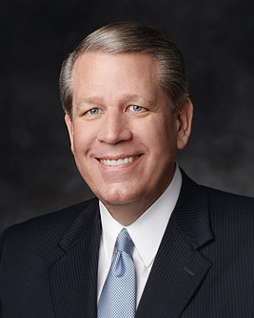
Scripture Mastery for 400
Elder Hallstrom taught us that we can change. We can’t use the excuse that; “that is just the way I am”. We can make weak things become strong.

Slide 10
Scripture Mastery for 400
Answer: What is Ether 12:27?
Back

Slide 11
Scripture Mastery for 500
Elder Holland spoke of persecution we as Saints may face. In order to have courage, he admonished us to build our Foundation of the Rock of our Redeemer.

Slide 12
Scripture Mastery for 500
Answer: What is Helaman 5:12?
Back

Slide 13
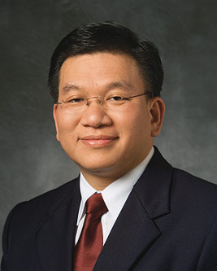
Scripture Mastery for 600
Elder Teh said we should build Christ like attributes of Faith, Hope, and Charity. These attributes are found in 2 scripture masteries in the same chapter.

Slide 14
Scripture Mastery for 600
Answer: What is Moroni 7?
Back

Slide 15
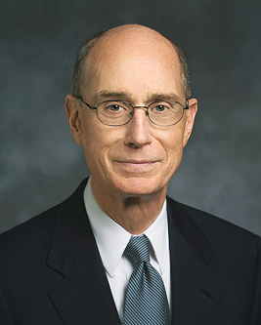
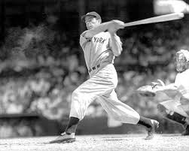
Stories that Teach for 100
President Eyring spoke of us being spiritual heroes to others. He told the story of his Father taking him to see one of his worldly heroes, Joe Dimaggio, at this famed stadium.

Slide 16
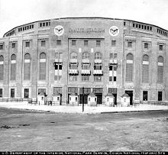
Stories that Teach for 100
Answer: What is Yankee Stadium?
Back

Slide 18
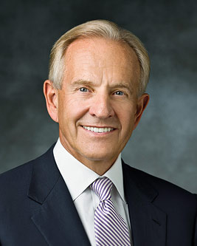
Stories that Teach for 200
Elder Zwick taught us to treat each other with kindness and love even when we disagree. He taught us to control our communication. He told the story of yelling at his wife the words, “What were you thinking?” when she did this. (Must tell the story)

Slide 19
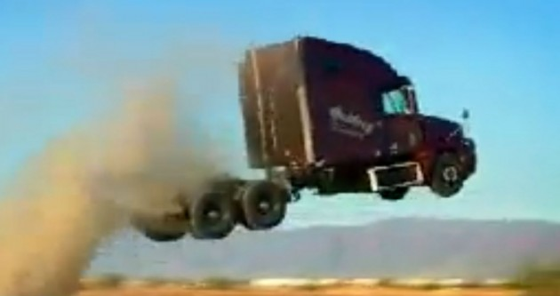
Stories that Teach for 200
Answer: What is jumped out of a Semi truck with their baby in arms?
Back

Slide 20
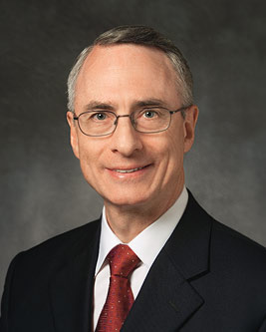
Stories that Teach 300
Elder Zivic taught us to stay on the path and follow the signs. He got lost while hiking to this famous landmark. (must tell story)

Slide 21
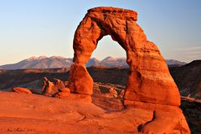
Stories that Teach for 300
What is Delicate Arch?
Back

Slide 22
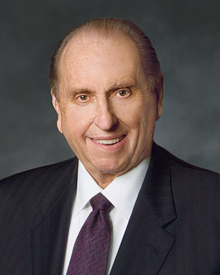
Stories that Teach for 400
President Monson taught us to Love our Neighbor and told the story of this small act of loving kindness between two co-workers which would eventually lead to the conversion of a whole family.(tell the story)

Slide 23
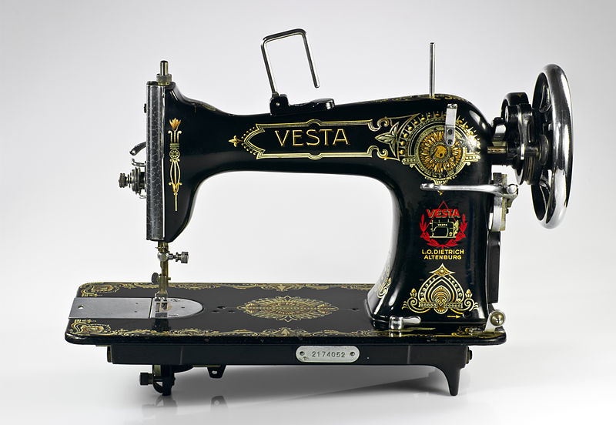
Stories that Teach for 400
What is to leave her sewing machine to help a coworker who was struggling?
Back

Slide 24
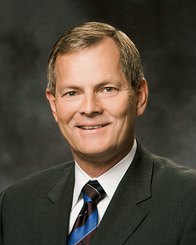
Stories that Teach for 500
Bishop Stevensen told the stories of 3 Mormon Olympic medal winners where fractions of seconds mattered. He then compared our lives to this many minutes.

Slide 25
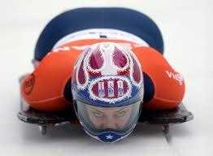
Stories that Teach for 500
Answer: What is 4 minutes?
Back

Slide 26
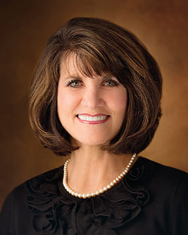
Stories that Teach for 600
Sister Stevens told the story of driving along a road and having a strong impression to do this. (Must tell the story)

Slide 27
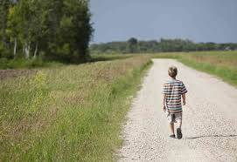
Stories that Teach for 600
Answer: What is to go help a boy who was walking along the road?
Back

Slide 28
Conference Humor 100
President Monson spoke of a celebration for the dedication of this most recent temple. The Saints had been praying for rain for months previous, and unfortunately the rain came throughout the entire celebration.

Slide 29
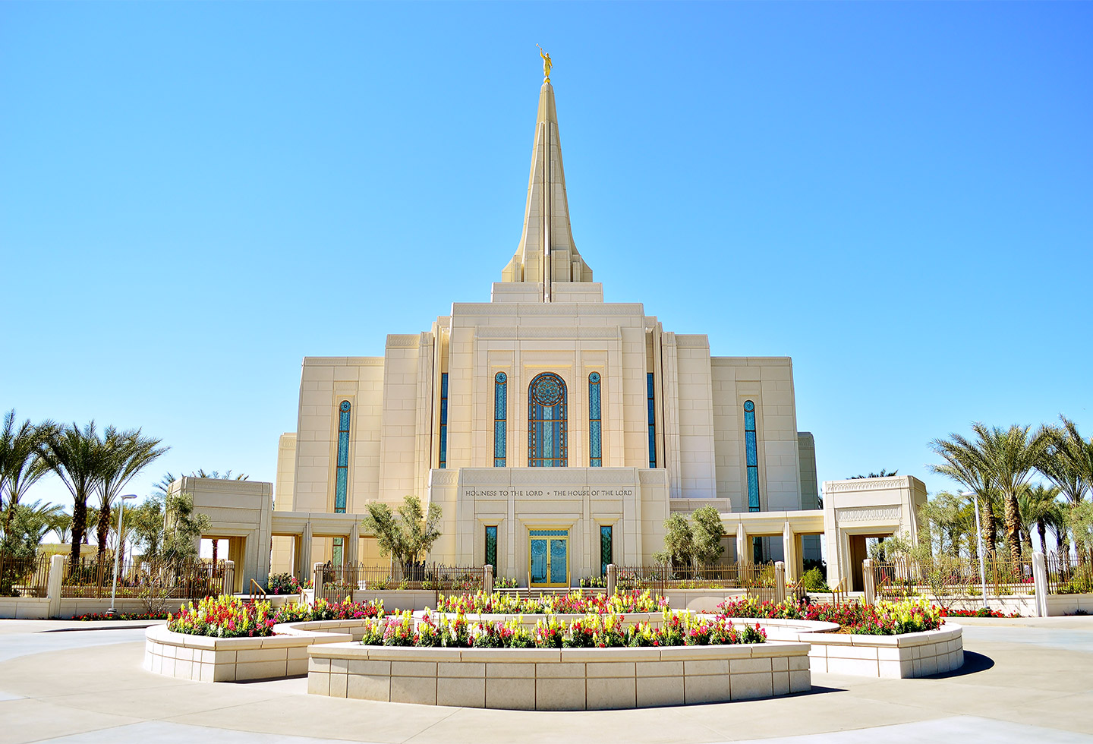
Conference Humor For 100
Answer: What is the Gilbert Arizona Temple
Back

Slide 30
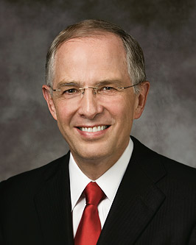
Conference Humor For 200
Elder Anderson spoke of the whirlwinds in our lives and told a humorous story of a tornado that did this to a mobile home.

Slide 31
Conference Humor For 200
What is the mobile home landed perfectly on another mobile home?
Back

Slide 32
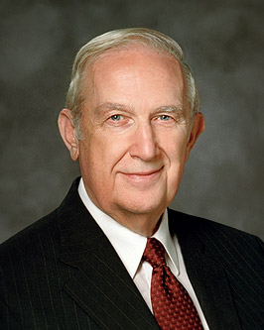
Conference Humor For 300
Elder Scott spoke of the importance of righteous influences. He told of how his future wife influenced him to go on a mission by telling him this.

Slide 33
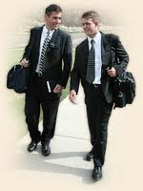
Conference Humor For 300
What is “my future husband is going to be a faithful returned missionary”?
Back

Slide 34
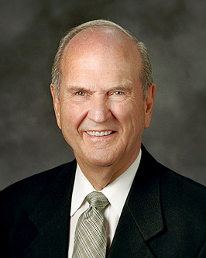
Conference Humor For 400
Elder Nelson spoke on having faith and told the story of a woman on his plane that was screaming with fear due to turbulence. Her husband apologized to Elder Nelson telling him that he tried to calm her by telling her this?

Slide 35
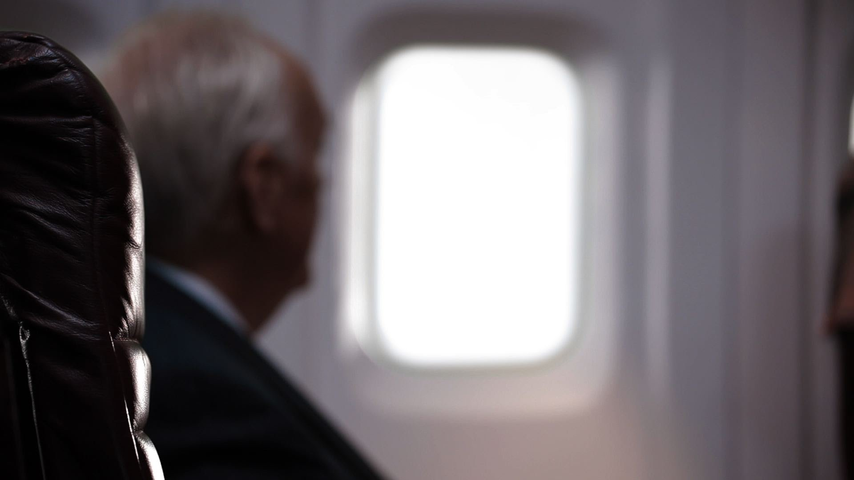
Conference Humor For 400
Answer: What is that Elder Nelson is on the plane so we are safe?
Back

Slide 36
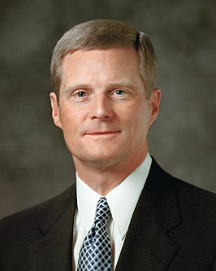
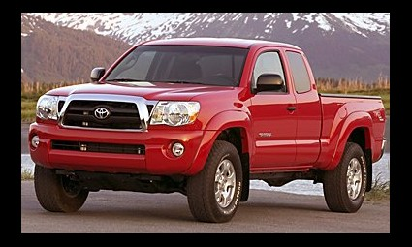
Conference Humor For 500
Elder Bednar spoke of a friend who wanted a new pick-up truck. His wife didn’t see the need. The husband then gave this perfectly reasonable explanation as to why they needed the truck.

Slide 37
Conference Humor For 500
Answer: What is “what if there was a big snow storm and we needed milk for the kids”?
Back

Slide 38
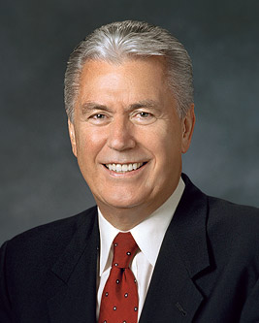
Conference Humor For 600
President Uchtdorf spoke of selfishness, and pointed out that this similar word was this years word of the year from the Oxford Dictionary.

Slide 39
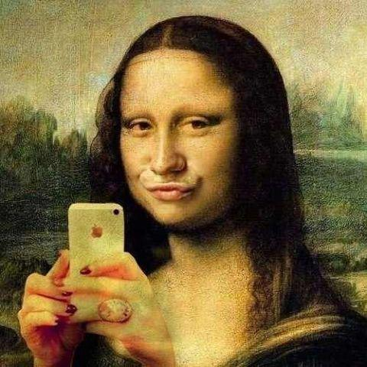
Conference Humor For 600
Answer: What is selfie?
Back

Slide 40
Doctrines 100
President Uchtdorf spoke about the attitude of Gratitude; being grateful in no matter what circumstances we find ourselves in, and quoted from this popular song of Gratitude.
(Must find in Hymnbook)

Slide 41
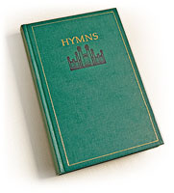
Doctrines 100
What is Hymn #241, Count Your Blessings?
Back

Slide 42
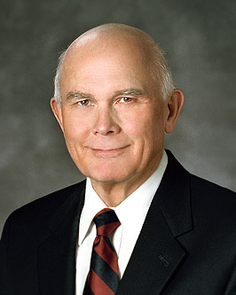
Doctrines 200
Elder Oaks gave a masterful sermon on Priesthood. He explained that woman may not be able to hold offices in the priesthood but that doesn’t mean they can’t have this element of the Priesthood.

Slide 43
Doctrines 200
Answer: What is authority?
Back

Slide 44
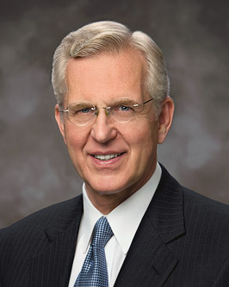
Doctrines 300
Elder Christofferson spoke in detail about this glorious doctrine that we celebrate this month.

Slide 45
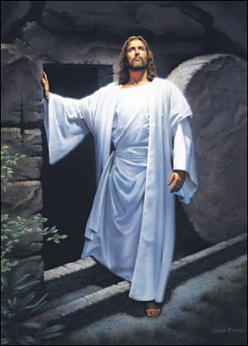
Doctrines 300
What is the resurrection of Jesus Christ?
Back

Slide 46
Doctrines 400
President Monson spoke on our need for Courage. He told us that if we ever find ourselves in a place we shouldn’t ought to be, we should do this.

Slide 47
Doctrines 400
What is “Get Out”?
Back

Slide 49
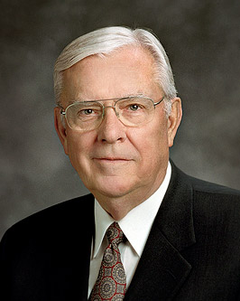
Doctrines 500
Elder Ballard spoke about follow-up. He followed up on these two subjects he has spoke of in the past.

Slide 50
Doctrines 500
Answer: What is using the Full name of the Church, and sharing the gospel.
Back

Slide 51
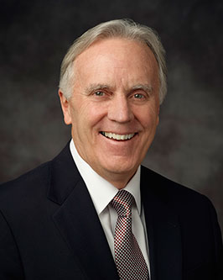
Doctrines 600
Elder Corbridge spoke of the Restoration of many true doctrines through the Prophet Joseph Smith. He said there is no dispute of the accomplishments of Joseph, just how he accomplished them, He is either a pretender or this?

Slide 52
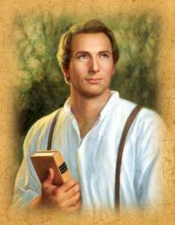
Doctrines 600
What is a prophet?
Back

Slide 53
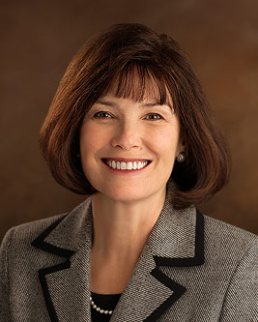
Grab Bag For 100
Sister Reeves gave a wonderful talk on the dangers of pornography. She counseled us to have family prayer, scripture study, and FHE. She informed us that these, not computers are the greatest culprit when it comes to viewing pornography.

Slide 54
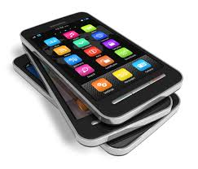
Grab Bag For 100
Answer: What is hand held devices (smart phones)?
Back

Slide 55
Grab Bag For 200
In the statistical report they announced that we currently have this many missionaries serving. (within 1000)

Slide 56
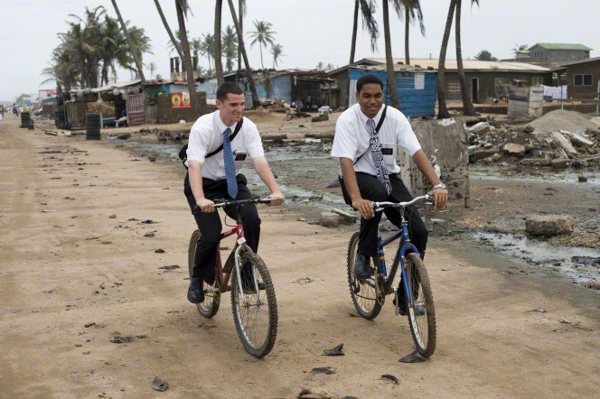
Grab Bag For 200
Answer: What is 85,039?
Back

Slide 58
Grab Bag For 300
This apostle spoke of how he gained a witness (testimony) while serving in WW2. He spoke sitting down. He had Polio as a child and no longer has use of his legs. He loves to carve birds?

Slide 59
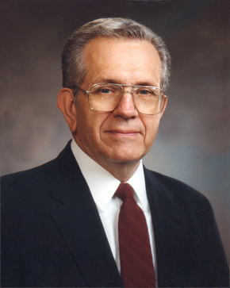
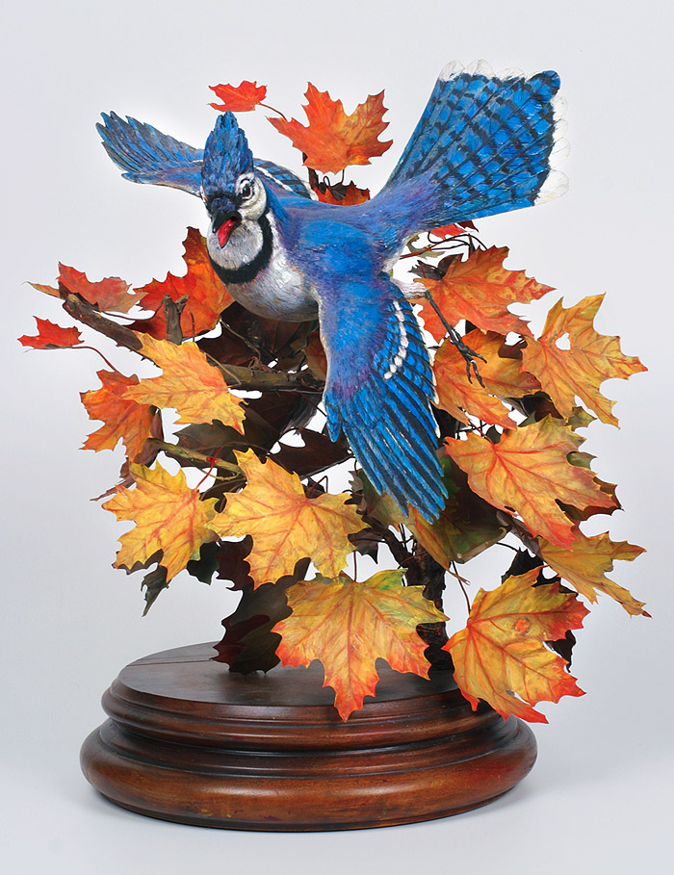
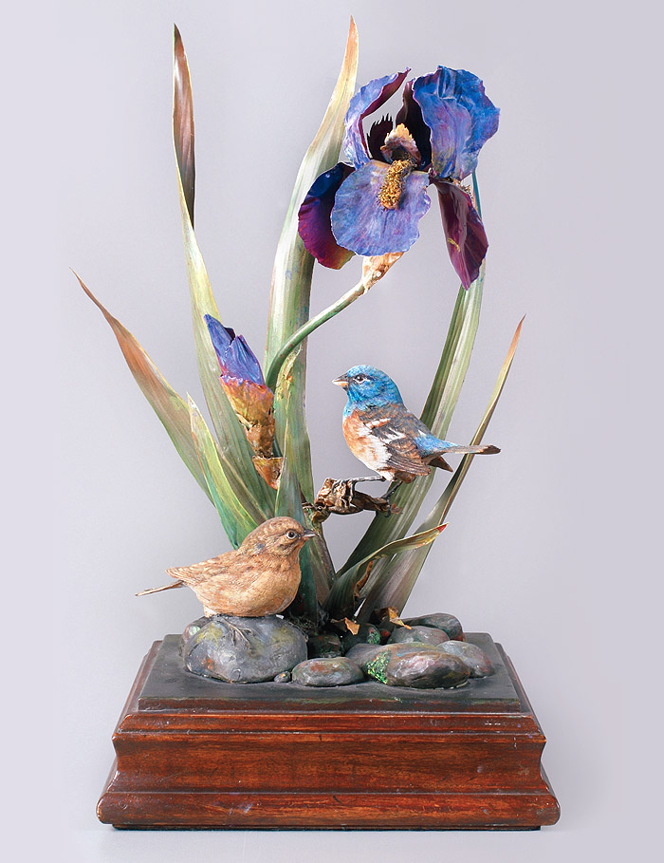
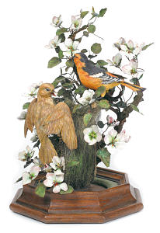
Grab Bag For 300
Who is President Boyd K. Packer, and yes, these are some of his carvings.
Back

Slide 60
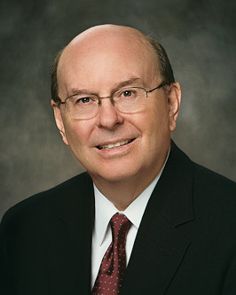
Grab Bag For 400
Elder Cook spoke on the importance of Family History Work and the Spirit of Elijah. He mentioned that this percent of the Church now lives within 200 miles of a temple.

Slide 61
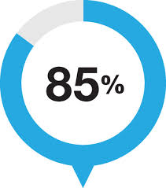
Grab Bag For 400
What is 85%?
Back

Slide 62
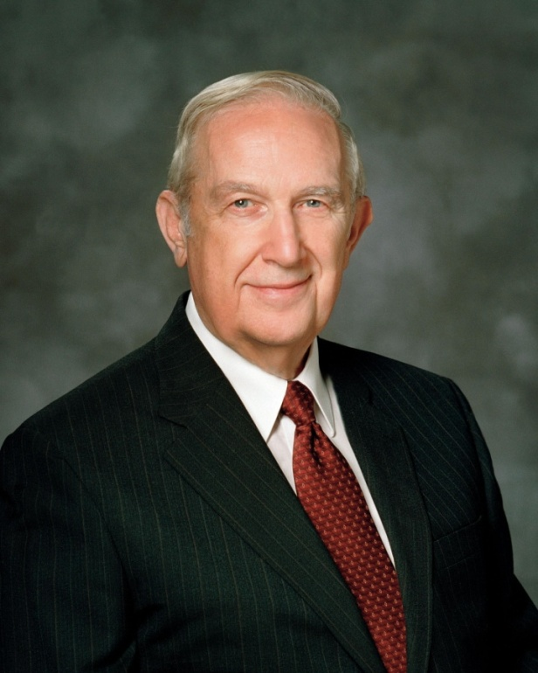
Grab Bag For 500
This Apostle was a nuclear scientist and is the only single member of the Quorum of the 12. (Full Name)

Slide 63
Grab Bag For 500
Who is Richard G. Scott?
Back

Slide 64
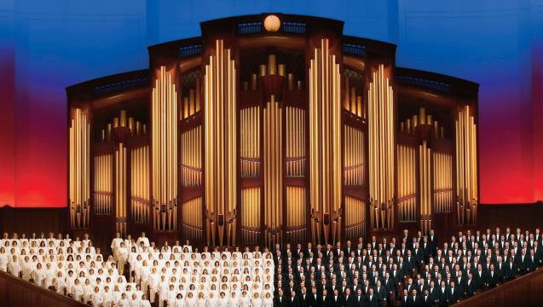
Grab Bag For 600
Elder Walker spoke of standing for truth and quoted from the great hymn about being true to the truth that our parents have cherished. (Must find in the Hymnbook)

Slide 65
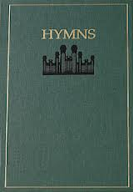
Grab Bag For 600
What is Hymn 254; True to the Faith
Back

Slide 66
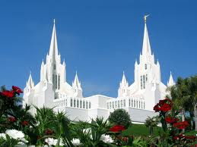
Final Jeopardy
Wager your points now…
HINT #1 – Topic: Temples

Slide 67
QUESTION:
Although, no new temples were announced; what is the total number of temples that are built, under construction, or have been announced (Within ten).
(Write your answer)

Slide 68
FINAL ANSWER
What is 170?

