Slide 1
Daughters in My Kingdom
The History and Work of Relief Society
Notes:
In the first meeting of the Relief Society, Sister Emma Smith said, “We are going to do something extraordinary.” She was right. The history of Relief Society is filled with examples of ordinary women who have accomplished extraordinary things as they have exercised faith in Heavenly Father and Jesus Christ.

Slide 2
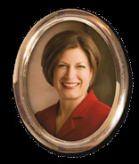
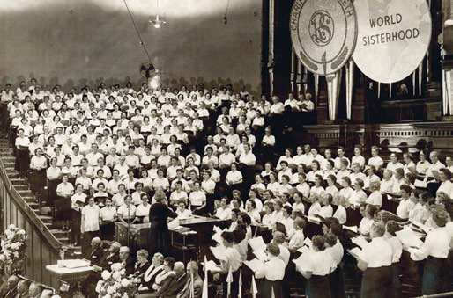
Tie Yourself to Relief Society
Notes:
Our General Relief Society President, Sister Julie Beck has said, “When I was newly married . . . My parents, who had been my neighbors, announced that they would be moving to another part of the world. I had relied on my mother’s nurturing, wise, and encouraging example. Now she was going to be gone for a long time. This was before e-mail, fax machines, cell phones, and Web cameras, and mail delivery was notoriously slow. One day before she left, I sat weeping with her and asked, ‘Who will be my mother?’ Mother thought carefully, and with the Spirit and power of revelation which comes to women of this kind, she said to me, ‘If I never come back, if you never see me again, if I’m never able to teach you another thing, you tie yourself to Relief Society. Relief Society will be your mother.’ “Mother knew that if I was sick, the sisters would take care of me, and when I had my babies, they would help me. But my mother’s greatest hope was that the sisters in Relief Society would be powerful, spiritual leaders for me. I began from that time to learn abundantly from women of stature and faith.”

Slide 3
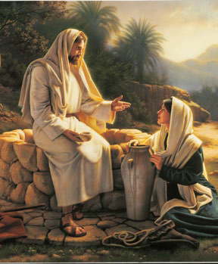
Relief Society
A Restoration of an Ancient Pattern
Notes:
Eliza R. Snow said, “Although the name may be of modern date, the institution is of ancient origin. We were told by our martyred prophet that the same organization existed in the church anciently.”

Slide 4
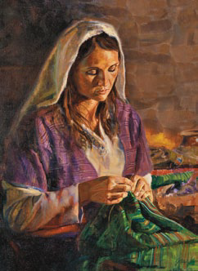
Tabitha “was full of good works”
Notes:
In the book of Acts there is an account of a woman named Tabitha, also known as Dorcas, who lived in Joppa, where she made clothes for women in need. It came to pass . . . that Tabitha was sick and died . . . When the Apostle Peter came to Joppa all widows stood by him weeping, and shewing the coats and garments which Dorcas made for them while she was with them. “But Peter put them all forth, and kneeled down, and prayed; and turning him to the body said, “Tabitha, arise.” And she opened her eyes: and when she saw Peter, she sat up.” Tabitha’s example is one we can follow today.

Slide 5
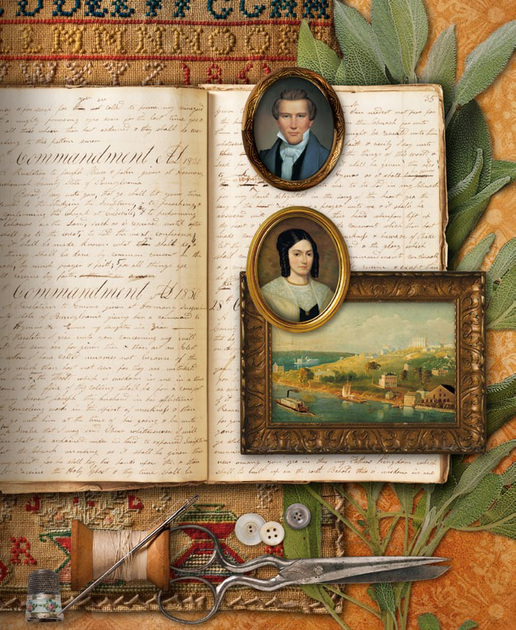
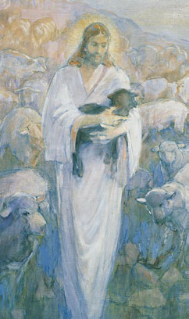
“Something Better”
Notes:
In the early days of the church, it was a popular practice for women to form their own organizations, often with constitutions and by-laws. A group of women met at Sarah Kimball’s home and decided to establish such a group. Eliza R. Snow accepted the responsibility to write the constitution and by-laws. Then the women asked Joseph Smith to review them and give them his opinion. After the Prophet read them, he said they were “the best he had ever seen and to tell the sisters their offering is accepted of the Lord, but He has something better for them than a written constitution.’ He invited them all to meet with him the next Thursday afternoon and said, “I will organize the women under the priesthood after the pattern of the priesthood.”
* In what ways do you think the Relief Society is organized ‘after the pattern of the priesthood’?

Slide 6
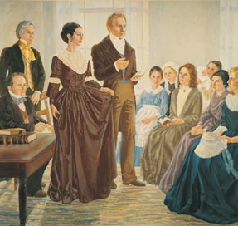
Organizing the Relief Society
March 17, 1842
Notes:
That next Thursday twenty women assembled direction of Joseph Smith and two members of the Quorum of the Twelve Apostles . . . They told the sisters that they were to encourage “the brethren to good works in looking to the wants of the poor— searching after objects of charity, and in administering to their wants—to assist by correcting the morals and strengthening the virtues of the female community.”

Slide 7
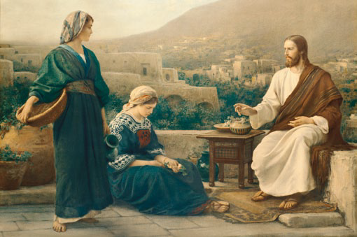
What is it we are to give ‘relief’ from?
Notes:
John A. Widtsoe: “Relief of poverty, relief of illness; relief of doubt, relief of ignorance—relief of all that hinders the joy and progress of woman.”

Slide 8
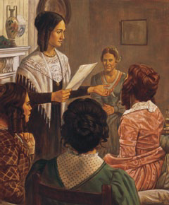
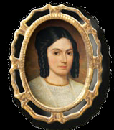
Relief Society Grew Rapidly
The Relief Society reached 1,1000 members in just 5 months.
Notes:
Relief Society of Nauvoo grew rapidly, reaching a membership of more than 1,100 in August 1842. Initially, membership in the society was not automatic for all female members of the Church. Women had to petition to belong, and they were accepted based on their goodness and virtue. Sisters in Nauvoo clamored to join the Relief Society. They were excited to give temporal and spiritual aid . . . They also recognized the unparalleled opportunity to be taught by a prophet in preparation for higher spiritual knowledge and the blessings of the temple.

Slide 9
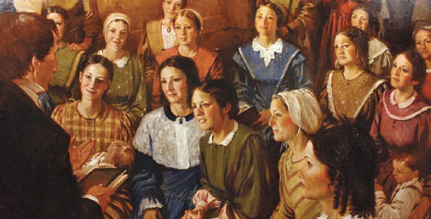
The Prophet Joseph Smith Instructed Relief Society Sisters
Notes:
The sisters were blessed to be taught by the Prophet Joseph Smith in six of their meetings. Sister Snow recorded, “The Spirit of the Lord was poured out in a very powerful manner, never to be forgotten . . . “ He taught them about the purposes of Relief Society.

Slide 10
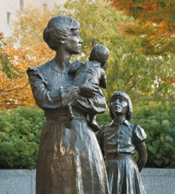
What are the three purposes of Relief Society?

Slide 11
Increase Faith and Personal Righteousness
Strengthen Families and Homes
Seek Out and Help
Those in Need

Slide 12
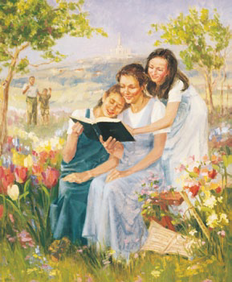
Increase Faith and Personal Righteousness
Notes:
The prophet Joseph Smith encouraged Relief Society sisters to be at peace with the Lord, with those around them, and with themselves: “Sisters . . . , shall there be strife among you? I will not have it—you must repent and get the love of God.” “Not war, not jangle, not contradiction, but meekness, love, and purity.”

Slide 13
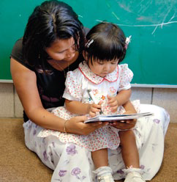
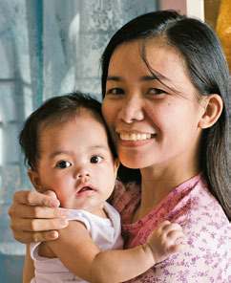
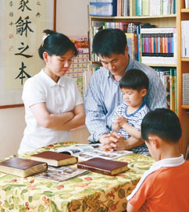
Strengthen Families and Homes
Notes:
When Relief Society sisters discussed ways to help people in their community, they often focused on families and homes. The minutes of their meetings are full of expressions such as the following: “Mrs. Hawkes spoke of the Drury family—still sick needing our prayers—if nothing more.” “Sister Joshua Smith . . . went and visited Sister McEwen and Sister Modley. Found them and their families in suffering want. They need attendance every day.” “P. M. Wheeler . . . would recommend
to the charity of this society Sister Francis Lew Law, who is sick and without a home, an aged widow lady at present destitute of money.”

Slide 14
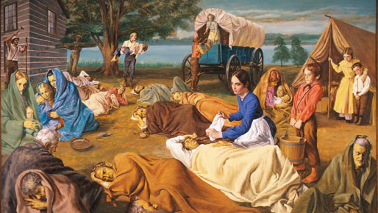
Seek Out and Help Those in Need
Notes:
The Prophet Joseph Smith taught, ““Don’t be limited in your views with regard to your neighbors’ virtues . . . . You must enlarge your souls toward others if you’d do like Jesus. . . . let your hearts expand you must be longsuffering and bear with the faults and errors of mankind. How precious are the souls of men!” “Nothing is so much calculated to lead people to forsake sin as to take them by the hand and watch over them with tenderness. When persons manifest the least kindness and love to me, O what power it has over my mind, while the opposite course has a tendency to harrow up all the harsh feelings and depress the human mind.”

Slide 15
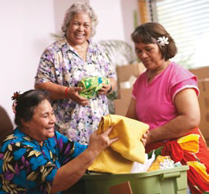
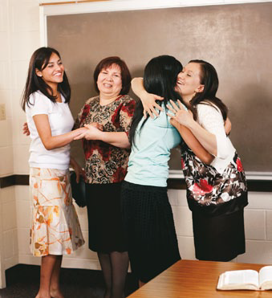
Can you think of a time when someone’s love for you changed your life?

Slide 16
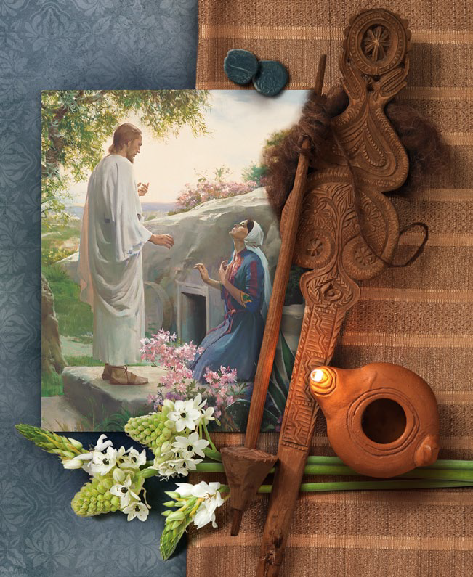
“Mary Magdalene was first at the resurrection; and the sisters now are the first to work on the inside of the temple.”
Joseph Smith
Notes:
Polly Angell recalled a comment by Joseph “The sisters are always first and foremost in all good works . . . . Mary Magdalene was first at the resurrection; and the sisters now are the first to work on the inside of the temple.”

Slide 17
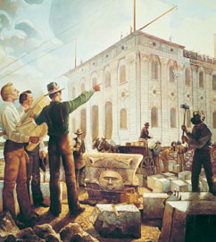
“The sisters are always first and foremost in all good works”
Joseph Smith
Notes:
“The women would churn and cheerfully send their butter to the workmen on the Temple and eat without any butter on their own tables.” The sisters also saw a need to make carpets and draperies for the temple.

Slide 18
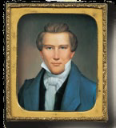
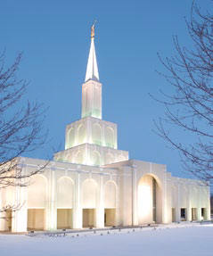
“Relief Society is not only to relieve the poor, but to save souls.”
Joseph Smith

Slide 19
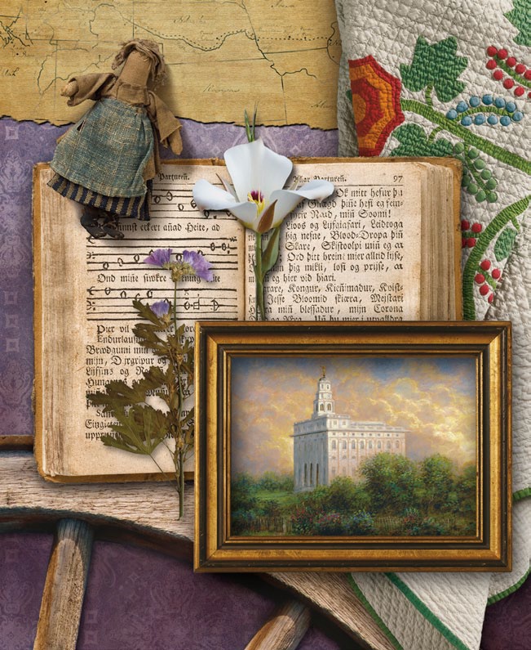
Notes:
On June 27, 1844, an armed mob advanced on a small jail in Carthage, Illinois, where Joseph Smith was imprisoned unjustly with his brother Hyrum and with Elders John Taylor and Willard Richards. When the mob left, Joseph and Hyrum were dead and Elder Taylor was wounded. The martyrdom of Joseph and Hyrum Smith did not put an end to the Saints’ faith and devotion. It also did not signal an end to the persecution of Church members. Because of continuing persecution, the Church’s new leader, President Brigham Young, eventually counseled the Saints to leave Nauvoo, Illinois, for a new home, where they hoped to live and worship in peace.

Slide 20
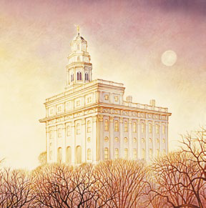
More than 5,000 Saints thronged the Nauvoo
Temple after its dedication so they could receive the endowment and the sealing ordinance before embarking on their journey into an unknown future.
Notes:
Before embarking on their journey into an unknown future, more than 5,000 Saints thronged the Nauvoo Temple so they could receive the endowment and the sealing ordinance. They came to the temple all day and long into the night. President Brigham Young wrote that they were so anxious to receive their ordinances that “I have given myself up entirely to the work of the Lord in the Temple night and day, not taking more than four hours sleep, upon an average, per day, and going home but once a week.”

Slide 21
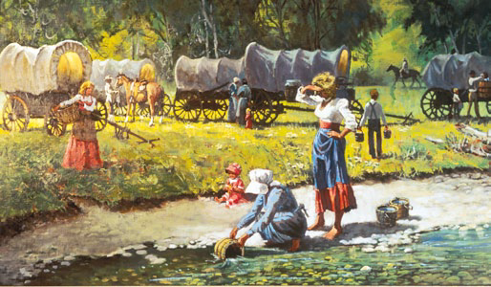
Notes:
Like many Relief Society sisters, Sarah Rich was buoyed by temple blessings as she faced the challenges of the exodus. She wrote, “ . . . if it had not been for the faith and knowledge that was bestowed upon us in that temple by the influence and help of the Spirit of the Lord, our journey would have been like one taking a leap in the dark. To start out . . . in the winter as it were and in our state of poverty, it would seem like walking into the jaws of death. But we had faith in our Heavenly Father, and we put our trust in Him feeling that we were His chosen people and had embraced His gospel, and instead of sorrow, we felt to rejoice that the day of our deliverance had come.”

Slide 22
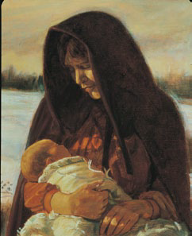
“The Lord has beheld our sacrifice: come after us.”
Notes:
Before leaving Nauvoo, a group of Latter-day Saints wrote a message on the wall of their abandoned temple: “The Lord has beheld our sacrifice: come after us.” “When the Saints left Nauvoo and during their journeyings, the Relief Society meetings were necessarily discontinued, though the sisters never lost sight of the institution, nor the promises made to them by President Joseph Smith, but continued their benevolent work wherever and whenever an opportunity presented itself . . .”

Slide 23
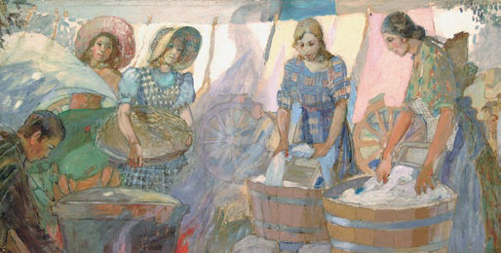
The sisters “were always ready with willing hands
and tender sympathies to perform deeds of love”.
Emmeline B. Wells
Notes:
A prominent non–Latter-day Saint historian wrote: “That I do not accept the faith that possessed them does not mean I doubt their frequent devotion and heroism in its service. Especially their women. Their women were incredible.” Though sickness was often rampant and the death rate was high, sisters found ways to serve. In 1854, Sister Dudley sensed needs among local American Indians and, under the direction of her bishop, organized sisters to make clothing for them.
In 1854, Matilda Dudley sensed many needs among local American Indians . . . she organized sisters under the direction of her bishop to make clothing for native women and children.

Slide 24
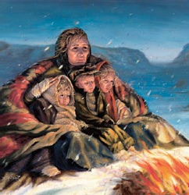
In 1856, Relief Society sisters gathered quilts for suffering handcart pioneers.
Notes:
At the October 1856 general conference, President Brigham Young announced that handcart pioneers were stranded hundreds of miles away. He declared: “Your faith, religion, and profession of religion, will never save one soul of you in the celestial kingdom of our God, unless you carry out just such principles as I am now teaching you. Go and bring in those people now on the plains, and attend strictly to those things which we call temporal, otherwise your faith will be in vain.” Lucy Meserve Smith . . . led a group of Latter-day Saint women in Provo, Utah. She and other sisters responded to calls to help Latter-day Saints who arrived in Utah. Sister Smith recorded in her autobiography that after President Young’s exhortation, those in attendance took action to provide relief for their brothers and sisters. Women “stripped off their petticoats, stockings, and everything they could spare, right there in the Tabernacle, and piled them into the wagons to send to the Saints in the mountains.”

Slide 25
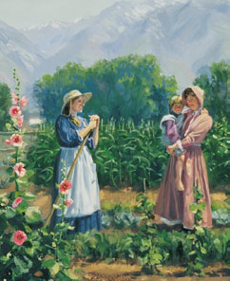
Do you have examples from your pioneer heritage . . . or ancestors . . .of women who served others?

Slide 26

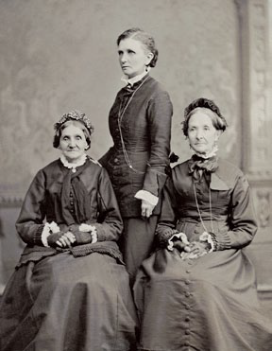
Relief Societies were Established Throughout the Church
Notes:
In 1866 . . . President Brigham Young expressed a desire to reestablish Relief Societies throughout the Church. He felt increased urgency to assist bishops in their responsibility to seek out and help those in need. He counseled bishops to: “Let the sisters organize Relief Societies in the various wards. We have many talented women among us, and we wish their help in this matter. Some may think this is a trifling thing, but it is not; and you will find that the sisters will be the mainspring of the movement . . . they will find rooms for the poor and obtain the means for supporting them ten times quicker than even the Bishop could.”

Slide 27
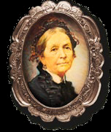
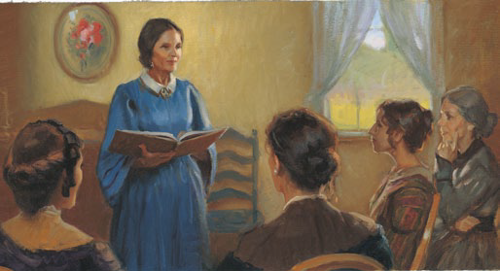
Relief Societies were established not only for the relief of the poor, but for every good and noble work.
Notes:
President Young called Sister Eliza R. Snow to travel throughout the territory, helping bishops organize Relief Societies. He also said, “I want you to instruct the sisters.” . . . she was given the same responsibilities the Lord had given Sister Emma Smith: “to expound scriptures, and to exhort the church, according as it shall be given thee by my Spirit.”

Slide 28
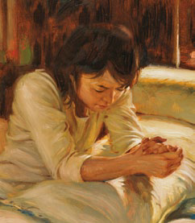
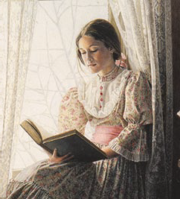
Seek the Holy Spirit
Notes:
Eliza R. Snow taught that if sisters would continually seek guidance and comfort from the Holy Ghost, they could enjoy peace even in the midst of adversity. She
said that the Holy Ghost “satisfies and fills up every longing of the human heart, and fills up every vacuum. When I am filled with that Spirit,” she continued, “my soul is satisfied, and I can say in good earnest, that the trifling things of the day do not seem to stand in my way at all. But just let me lose my hold of that
spirit and power of the Gospel, and partake of the spirit of the world, in the slightest degree, and trouble comes . . . I am tried, and what will comfort me? . . . is it not our privilege to so live that we can have this constantly flowing into our souls?” *Will you share with us a time when you were comforted by the Holy Spirit?

Slide 29
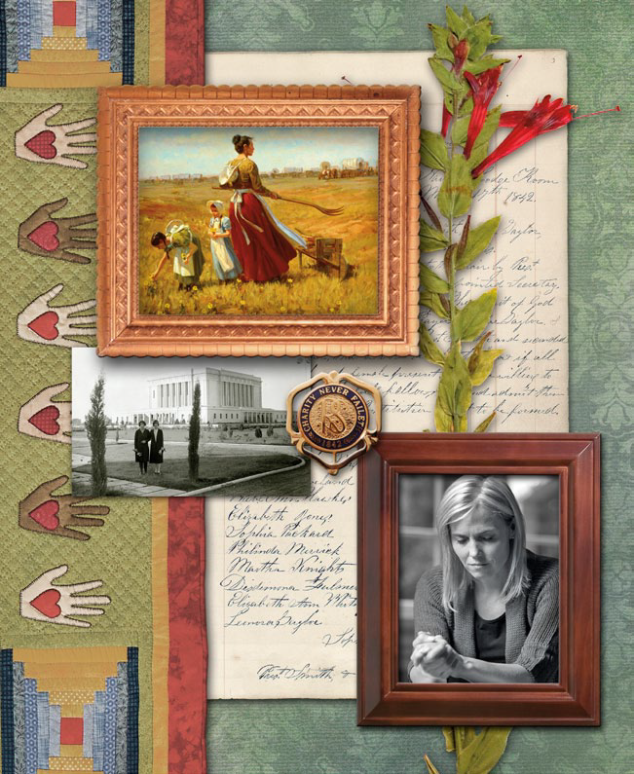
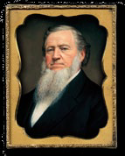
President Brigham Young
instructed sisters to “retrench in everything that is bad and worthless, and improve in everything that is good and beautiful.” He counseled sisters to reform their eating and housekeeping patterns.

Slide 30
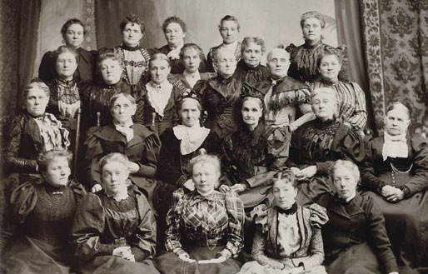
Be Articulate . . . Frequently Share Your Knowledge and Testimony
Notes:
Sister Eliza R. Snow was a gifted writer and public speaker. She frequently shared her knowledge and her testimony, and she encouraged Latter-day Saint women to do the same in Relief Society meetings—not to depend on others to always teach them. Some women felt reluctant and unprepared to speak in public. Sister Snow gave the following counsel to such sisters: “Do not let your president have to say all. . . . Has not God endowed you with the gift of speech? . . . If you are endowed with the Spirit of God, no matter how simple your thoughts may be, they will be edifying to those who hear you.” Emily S. Richards said that Sister Snow helped her learn to speak in public: “The first time she asked me to speak in meeting, I could not, and she said, ‘Never mind, but when you are asked to speak again, try and have something to say,’ and I did.” Sister Richards continued to improve in her ability as a public speaker, and in 1889 she spoke at the National Woman Suffrage Association convention in Washington, D. C. [seeking the right to vote for women]. A journalist described Sister Richards as “trembling slightly under the gaze of the multitude, yet reserved, self-possessed, dignified, and as pure and sweet as an angel. . . . It was not the words themselves, but the gentle spirit that went with the words and carried winning grace to every heart.”

Slide 31
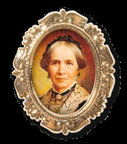
Seek for a testimony, as you would, my dear sisters, for a diamond concealed.”
Zina D.H. Young
Notes:
Seek for a testimony, as you would, my dear sisters, for a diamond concealed. If someone told you by digging long enough in a certain spot you would find a diamond of unmeasured wealth, do you think you would begrudge time or strength, or means spent to obtain that treasure? . . . If you will dig in the depths of your own hearts you will find, with the aid of the Spirit of the Lord, the pearl of great price, the testimony of the truth of this work.”

Slide 32
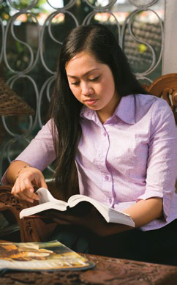
“We want our homes to be blessed with sister scriptorians.”
Pres. Spencer W. Kimball
Notes:
President Spencer W. Kimball said: “I stress . . . the deep need each woman has to study the scriptures. We want our homes to be blessed with sister scriptorians . . . as you become more and more familiar with the truths of the scriptures, you will be more and more effective in keeping the second great commandment, to love your neighbor as yourself. Become scholars of the scriptures—not to put others down, but to lift them up! After all, who has any greater need to ‘treasure up’ the truths of the gospel on which they may call in their moments of need than do women and mothers who do so much nurturing and teaching?” President Kimball testified that Relief Society sisters will become a powerful influence for good upon the “good women of the world” as they “reflect righteousness and articulateness
in their lives.” * What are some study methods that keep you motivated to learn from the scriptures?

Slide 33
Become Self-Reliant
Notes:
In what ways should we be self-reliant? What are some things we can do to become self-reliant?

Slide 34
Become Self-Reliant
Learn to love work and avoid idleness.

Slide 35
Become Self-Reliant
Learn to love work and avoid idleness.
Acquire a spirit of self-sacrifice.

Slide 36
Become Self-Reliant
Learn to love work and avoid idleness.
Acquire a spirit of self-sacrifice.
Accept personal responsibility for spiritual strength.

Slide 37
Become Self-Reliant
Learn to love work and avoid idleness.
Acquire a spirit of self-sacrifice.
Accept personal responsibility for spiritual strength.
Accept personal responsibility for health, education, employment, finances, food, and other life-sustaining necessities.

Slide 38
Become Self-Reliant
Learn to love work and avoid idleness.
Acquire a spirit of self-sacrifice.
Accept personal responsibility for spiritual strength.
Accept personal responsibility for health, education, employment, finances, food, and other life-sustaining necessities.
Pray for faith and courage to meet challenges that come.

Slide 39
Become Self-Reliant
Learn to love work and avoid idleness.
Acquire a spirit of self-sacrifice.
Accept personal responsibility for spiritual strength.
Accept personal responsibility for health, education, employment, finances, food, and other life-sustaining necessities.
Pray for faith and courage to meet challenges that come.
Strengthen others who need assistance.

Slide 40
“Think what it would be to hear your little one cry for bread.”
Notes:
President Young counseled the sisters, “Learn to sustain yourselves; lay up grain and flour, and save it against a day of scarcity.”

Slide 41
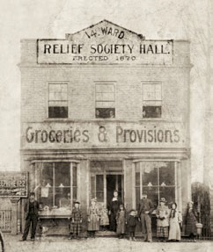
“Think what it would be to hear your little one cry for bread.”
Notes:
Emmeline B. Wells, who later became a general Relief Society president, was assigned to be in charge of the central wheat committee. . . . Women were motivated by their motherly desire to protect their families from hunger. Sister Wells said: “Who is there that can feel these things as deeply as a mother can? Think what it would be to hear your little one cry for bread.” Sarah M. Kimball, who also served as a ward Relief Society president, already had a storage plan in mind when she came to one meeting. In the first year of the project, her ward Relief Society built a fireproof granary with a capacity to store 1,000 bushels of wheat.

Slide 42
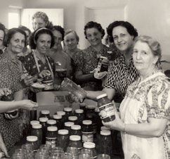
Saints are counseled to do all they can to provide the temporal necessities of life for themselves and their families.
Notes:
Brigham Young . . . wanted the saints to be independent from worldly influences, both temporally and spiritually. This meant that they needed to learn
skills that would allow them to take care of all their needs. While many specific temporal duties are different today, the principles behind these duties remain constant: Latter-day Saints are counseled to do all they can to provide the temporal necessities of life for themselves and their families.

Slide 43
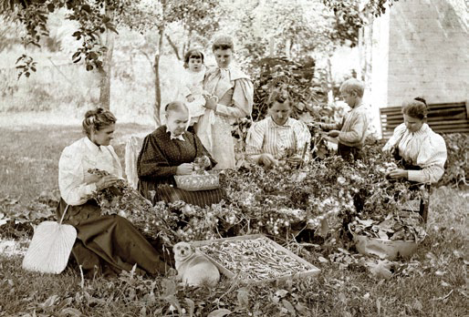
Notes:
President Young established the Deseret Silk Association, with Zina Young as its president. This group raised silkworms, feeding them mulberry leaves. Sister Young abhorred the worms and even suffered nightmares about them, but she obediently hatched and raised them in her own cocoonery and taught others to do the same. Under her direction, the Deseret Silk Association raised silkworms for over 20 years. The sisters were able to spin lovely silk for themselves.

Slide 44
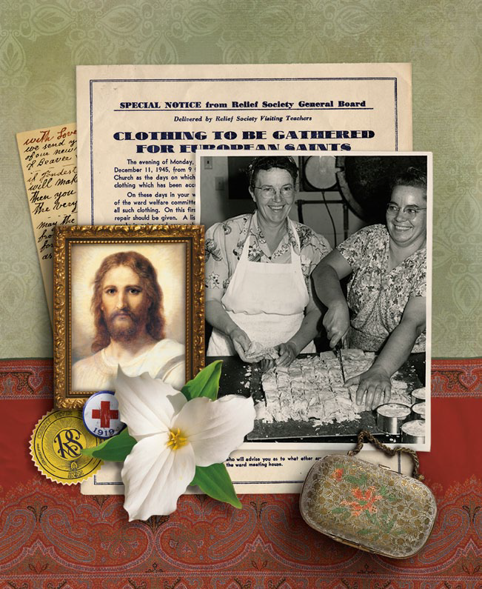
Being Prepared Allows Us
To Serve Others
Notes:
The sisters’ diligence in preserving wheat allowed Latter-day Saint women to serve people beyond their families and fellow Saints. The Church sent Relief Society wheat to American Indians in Utah; to survivors of a terrible earthquake and fire in San Francisco, California, in 1906; and to people in China who were
suffering from a famine in 1907. The wheat also provided nourishment for thousands during World War I, when the Relief Society sold 200,000 bushels to the United States government.

Slide 45
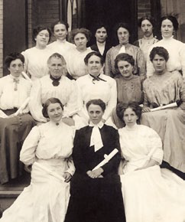
Education is Encouraged
Notes:
President Brigham Young wanted “a good many sisters to get a classical education, and then get a degree for Medicine.” With this encouragement, some Relief
Society sisters studied medicine in the eastern United States. They came back to Utah as doctors and taught classes in midwifery and home nursing. Emma Liljenquist, who attended the classes in Utah, recorded some of her experiences: “after being set apart . . . I was promised by the Apostles that if I lived right I should always know what to do in case of any difficulties . . . . “That promise has been fulfilled to the very letter. Many times when one of my patients
was seriously ill, I have asked my Heavenly Father for assistance, and in every case it was given to me. One in particular was a lady who had just given birth to a baby and hemorrhage set in. The husband called the doctor, but he did not realize that it was so serious. I . . . Asked the Lord to help us. The hemorrhage ceased
and I did the necessary things for her. When the doctor arrived, he said he could hardly believe what had happened, but said I had done exactly what he would have done. . . . I have brought over one thousand babies into the world. Once again I give thanks to my Heavenly Father for His help and the strength the Lord has given me, for without it I could not have rendered this service to my sisters or our community. One of the most touching things about a birth is that the mother’s first
concern is about her baby, not herself.”

Slide 46
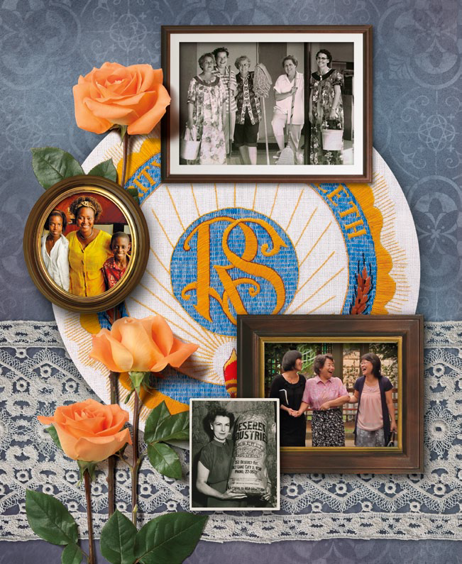
Charity Never Faileth
Notes:
“Charity never faileth.” These three words embraced the charge that the Prophet Joseph Smith had given the Relief Society sisters: to “relieve the poor” and to “save souls.” In the past, pioneer women had practiced charity for close neighbors. Now Relief Society sisters organize themselves to extend charity, “the pure love of Christ,” to worldwide neighbors as well. Sister Wells and her counselors established this motto in a time of relative peace and prosperity. Little did they know how events in the coming years would put their motto to the test.

Slide 47
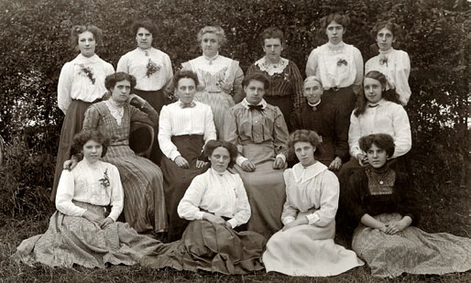
Live Peaceably in Time of War
Relief Society sisters in Kidderminster, England
Notes:
War broke out in Europe in 1914 . . . when bitterness and intolerance could have threatened the charitable feelings expected from Relief Society sisters, Sister
Emmeline B. Wells and her counselors issued the following message “Administer in the spirit of love and patience to your husbands and to your children; guard
the little ones; do not permit them to imbibe the spirit of intolerance or hatred to any nation or to any people; keep firearms out of their hands; do not allow them to play at war nor to find amusement in imitating death in battle; inculcate the spirit of loyalty to country and flag, but help them to feel that they are soldiers of the Cross and that if they must needs take up arms in the defense of liberty, of country and homes they shall do so without rancor or bitterness. . . . Teach the peaceable things of the kingdom and look after the needy more diligently than ever.” She encouraged them to be patient with loved ones and kind toward neighbors—including enemies—and to give service to those in need. This love would sustain them through seasons of war and peace.

Slide 48

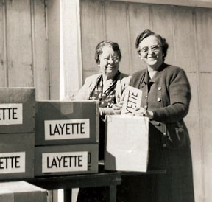
Relief Society is Divinely Inspired
Relief Society sisters preparing sets of baby clothes for families in need
Notes:
During World War I, the Relief Society in the United States cooperated wholeheartedly with community organizations such as the National Council of Defense and the American Red Cross. The sisters participated in food production, fund-raising, sanitation, and child welfare work. They were effective and energetic in cooperating with these community efforts. However, their prophet reminded them that they must never lose sight of the divine origins of Relief Society. President Joseph F. Smith said that while worldly organizations “are men-made, or women-made,” the Relief Society “is divinely made, divinely authorized, divinely instituted, divinely ordained of God to minister for the salvation of the souls of women and of men.” He did not want “to see the time when our Relief Societies will follow, or co-mingle and lose their own identity by mixing up with these woman-made organizations that are coming to pass. . . . It is for you,” he told Relief Society sisters, “to lead the world and to lead especially the women of the world, in everything that is praise-worthy, everything that is God-like, everything that is uplifting and that is purifying to the children of men. You are the head, not the tail.”

Slide 49
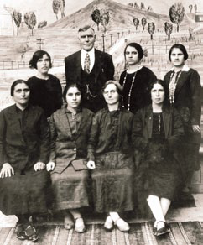
Love
Notes:
In addition to working with other organizations, Relief Society sisters did a variety of things on their own and with their wards to provide goods and raise money for those in need. Some sisters made and sold dresses, aprons, children’s clothing, quilts, and handwoven hats and rugs. Some raised and sold cattle and sheep.
A sister in Tooele, Utah, learned that a quilt she made had offered relief to a British family during the war. This Relief Society sister had made the quilt in 1906, tucked a note inside it, and sent it to San Francisco, California, to help victims of a terrible earthquake. Eleven years later, the quilt was given to the Red Cross and sent to Great Britain. When the British recipient found the note, she sent a personal thank-you letter, saying that the quilt “came in very useful, as I lost my
husband at the front.” She had been left with eight children and no possibility of working. This widow admitted, “It is as much as I can do to keep going.”

Slide 50
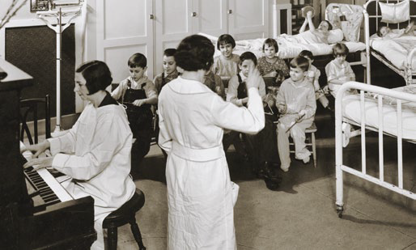
Nurses Trained
Hospital Established
Notes:
The Relief Society general presidency sponsored a program for training nurses. This one-year course, which began at LDS Hospital in Salt Lake City, Utah, did not charge tuition. Instead, the students were required to give 30 days of free nursing service in their communities. After 4 years, in which 46 aides were trained, the Relief Society discontinued the program and transferred their support to Red Cross home-nursing courses. Sister Williams was concerned about the high mortality rate of mothers and infants. In 1924, with support and encouragement from general and local priesthood leaders, the Cottonwood Stake Relief Society established a maternity hospital. This hospital later became part of a network of Church hospitals.

Slide 51

Louise Y. Robison,
Seventh Relief Society General President
Notes:
In 1928, President Heber J. Grant called Sister Louise Robison to serve as the General Relief Society President. The at the end of 1929, with little warning, the world plunged into a great economic depression. Challenges were not new to Sister Robison. She had grown up in a humble log home in rural Scipio, Utah, where she had learned to farm, garden, sew, work hard, live on little, and be of good cheer. When Sister Robison had previously been called to serve as second counselor in the general Relief Society presidency she felt her inadequacies keenly. Her daughter recounted: “When Mother went to President Grant’s office to be set apart, she felt sure he had been misinformed about her abilities, so she told him she’d be happy to do her best in whatever he asked her to do, but she wanted him to know that she had a limited education, and very little money and social position, and she was afraid she wouldn’t be the example that the women of the Relief Society would expect in a leader. She finished by saying ‘I’m just a humble woman!’ President Grant answered, ‘Sister Louizy, 85% of the women of our Church are humble women. We are calling you to be the leader of them.’” Her advice to homemakers and mothers was practical and empathetic. She understood the struggle to live on a meager budget, and yet she knew the importance of a mother’s influence in the home. So she encouraged mothers to do all they could to stay at home with their children rather than leave them for the workplace.

Slide 52



Work
Notes:
In April 1936, the First Presidency introduced a Church-wide welfare program. President Heber J. Grant explained the purpose of the program. “Our primary purpose,” he said, “was to set up, in so far as it might be possible, a system under which the curse of idleness would be done away with, the evils of a dole abolished, and independence, industry, thrift and self respect be once more established amongst our people. The aim of the Church is to help the people to help themselves. Work is to be reenthroned as the ruling principle of the lives of our Church membership.” Relief Societies took a prominent role in ward welfare efforts. Under the direction of bishops, they appraised the needs of families and then provided dried and preserved fruits and vegetables, clothing, and bedding as needed. For a time, sisters who bottled fruit were asked to give up every tenth jar to the welfare program.

Slide 53

The sons of the Anti-Nephi-Lehies acquired great faith
through the teachings of their mothers (see Alma 56:47).
Notes:
From 1939 to 1945, World War II engulfed much of the world. Priesthood and auxiliary leaders were concerned that World War II was fragmenting homes and families. As men went to war, women had to sustain their families without immediate help from their husbands and older sons. Church leaders again encouraged
mothers with children at home to find ways, if possible, to provide for the children without working outside the home full-time. These leaders encouraged Relief Society sisters to develop foundational skills of self-reliance: quilting, sewing clothing, growing gardens, and preserving and storing fruits and vegetables.
They also emphasized the mother’s spiritual role in the home. Nations torn by war needed good young citizens who learned lessons of morality and uprightness from
their mothers.

Slide 54

Service and Love
1942: more than 10,000 Relief Society sisters completed Red Cross courses in home nursing, first aid, and nutrition

Slide 55

Service and Love
1947: American Indian Placement Program was established
Notes:
Many sisters served the youth directly by nurturing them as if they were their own children. The program continued until 1996. President Boyd K. Packer later observed: “The Indian Placement program filled its purpose, and it has been disbanded. And that happens. . . . We take the scaffolding down when construction is complete.”

Slide 56

Gertrude Zippro, center, with her sisters and children
Notes:
Relief Society sisters in Europe experienced great devastation from World War II. One sister wrote, “Some of us have lost all our earthly
possessions, every tangible thing ever dear to us, and when we say ‘It is better to walk with God in the darkness than without him in the
light,’ we know whereof we speak. . . . we put our trust in the Lord. He maketh all things well.” (Sister to read about Gertrude Zippro)

Slide 57

The Relief Society might be likened to a refuge—the place of safety and protection—the sanctuary of ancient times. You will be safe within it. It encircles each sister like a protecting wall.
Boyd K. Packer
A Worldwide Circle of Sisterhood
Notes:
When the Prophet Joseph Smith met with Relief Society sisters in Nauvoo, he taught that in addition to giving temporal service, they were to strengthen people spiritually. Relief Society has become a shelter from the world—a place of refuge—and a center of light to the world—a place of influence. In the mid-1900s, as the world suffered the effects of wars and natural disasters, the Relief Society’s work continued to expand. In 1947 the general Relief Society presidency taught, “Ours is a healing mission requiring the larger heart, the kindlier touch, the steadier will.” At that time, some governments established political restrictions and even built some physical barriers. These restrictions and barriers, known by names such as the Iron Curtain and the Berlin Wall, were designed to restrict some people and exclude others. In contrast, Relief Society sisters built spiritual walls of refuge designed to protect and include. They came together in a worldwide circle of sisterhood and invited others to join them. Even in countries with political boundaries and laws that prevented open participation in religion, members of Relief Societies felt a connection to their sisters throughout the world.

Slide 58

Notes:
In 1980, President Boyd K. Packer visited a Relief Society in Czechoslovakia. He later recalled: “It was not easy to obtain visas, and we used great care so as not to jeopardize the safety and well-being of our members, who for generations had struggled to keep their faith alive under conditions of unspeakable oppression.
“The most memorable meeting was held in an upper room. The blinds were drawn. Even at night, those attending came at different times, one from one direction and one from another, so as to not call attention to themselves. “There were in attendance twelve sisters. We sang the hymns of Zion from songbooks—words without music—printed more than 50 years before. A lesson was reverently given from the pages of a handmade manual. . . .“I told those sisters that they belonged to the largest and by all measure the greatest women’s organization on earth. I quoted the Prophet Joseph Smith when he and the Brethren organized the Relief Society. . . . “The Spirit was there. The lovely sister who had conducted wept openly. “I told them that upon our return I was assigned to speak at a Relief Society conference; could I deliver a message from them? Several of them made notes; each expression, every one, was in the spirit of giving—not of asking for anything. I shall never forget what one sister wrote: ‘A small circle of sisters send their own hearts and thoughts to all the sisters and begs the Lord to help us go forward.’ “Those words, circle of sisters, inspired me. I could see them standing in a circle that reached beyond that room and circled the world.”

Slide 59

“No matter where a family may go, a Church family awaits them.”
Boyd K. Packer
Notes:
President Packer said, “How consoling it is to know that no matter where a family may go, a Church family awaits them. From the day they arrive, he will belong to a quorum of the priesthood and she will belong to Relief Society.” *Have you had this experience when you have traveled or moved to a new area?

Slide 60

Influence Among Women Throughout the World
Sister Belle S. Spafford, left, at an International Council of Women convention
Notes:
Soon after Sister Spafford was called to be the General Relief Society President, a letter came from the National Council of Women, announcing
their annual meeting to be held in New York City. “Sister Spafford had attended those meetings before, and in view of her previous experience, she and her counselors carefully considered the invitation for several weeks. “They decided to recommend to the President of the Church that the Relief Society terminate its membership in those councils. They prepared a statement of recommendation, listing all of the reasons for so doing. “Trembling and uncertain, Sister Spafford placed the paper on the desk of President George Albert Smith, saying, ‘The Relief Society Presidency wishes to recommend that the General Board terminate its membership in the National Council and in the International Council of Women, for the reasons listed on this paper.’ “President Smith carefully read the paper. Had they not held membership for well over half a century? he inquired. “Sister Spafford explained how costly it was to go to New York, the time it took, and described the humiliation they occasionally experienced. She recommended that they withdraw because ‘we don’t get a thing from these councils.’ “This wise, old prophet tipped back in his chair and looked at her with a disturbed expression. ‘You want to withdraw because you don’t get anything out of it?’ he questioned. “‘That is our feeling,’ she replied. “‘Tell me,’ he said, ‘what is it that you are putting into it? “‘Sister Spafford,’ he continued, ‘you surprise me. Do you always think in terms of what you get? Don’t you think also in terms of what you have to give?’ “He returned that paper to her and extended his hand. With considerable firmness he said, ‘You continue your membership in these councils and make your influence felt.’” She did make her influence felt. She participated in the National Council of Women and the International Council of Women and held leadership positions in those organizations for years. She stood strong for the principles of the gospel of Jesus Christ and for the purposes of Relief Society. Every time Sister Spafford went to the International Council of Women, she was assigned to the “social and moral welfare” session. She recounted: “At one time I protested going back into the social and moral welfare session, and I was very friendly at that time with the president. . . . I said, ‘I go all the time to this session, and it’s just getting so sordid that I’d like a change.’ She said, ‘Well, you’re certainly entitled to one, and I’ll see that you get it.’ “Then she came back and said, ‘We can’t grant your request because your own council insists that you remain in the social and moral welfare.’ She said, ‘It may be of interest to you to know the reason. Your national president says you always stand by the position of your Church in these matters and they know the position of the Mormon Church and they feel there is safety in having you there.’”
Women in these organizations knew that their friend Belle Spafford would stand by the Church’s principles, and they needed that kind of wisdom and strength. In 1954 she was chosen as the leader of the United States delegation at the International Council of Women in Helsinki, Finland. As she led a grand march at the opening of the conference, her thoughts went back in time: “As I looked out at the glittering audience made up of people of many nations . . . , my mind suddenly flashed back to the words of our pioneer Relief Society leaders . . . ‘standing as we do at the head of the women of the world,’ . . . ‘for the rights of the women of Zion and the rights of the women of all nations.’ . . . I knew that our pioneer women leaders had been given by divine insight a knowledge of the destiny of Relief Society. . . . It is my conviction that the time had come for Relief Society’s influence to be felt worldwide among womankind.

Slide 61

President Spencer W. Kimball:
“Much of the major growth that is coming to the Church in the last days will come because many of the good women of the world will be drawn to the Church in large numbers . . .

Slide 62

This will happen to the degree that the women of the Church reflect righteousness and articulateness in their lives and to the degree that the women of the Church are seen as distinct and different—in happy ways—from the women of the world.”

Slide 63


Influencing Others Through Service
Notes:
In 1992, sisters all over the world celebrated the 150th anniversary of the Relief Society by participating in service projects in their communities. Sister Elaine L. Jack, who was serving as Relief Society general president at the time, said: “Can you imagine what that did in this world? One of our Relief Society presidents went to the city council in California and said, ‘What are the things that you feel are needed in this community that we could do?’ And the men said, ‘You mean 20,000 groups throughout this world are going to be doing this same thing?’ And she said yes. And one of the council members said, ‘You’ll change the world.’ And I think we did . . . for the better. . . . Sisters made lap rugs in South Africa for the elderly . . . . They planted flowers around a clock tower in Samoa. They helped with homeless shelters, provided books for children, and painted homes for unwed mothers. We felt that throughout the world these community service projects were a great thing, both for the sisters and for the community.”
*What Relief Society service projects have you been involved in and how did they touched your life? (100 dresses)

Slide 64

Influencing Others Through Literacy
Notes:
As Relief Society sisters organized community service projects, Sister Jack and her counselors focused on a worldwide service effort: helping sisters learn to read. “We felt that women throughout the world needed to be able to read, and there were many who could not,” she said. “Can you imagine—if they didn’t know how to
read, how could they teach their children, how could they improve their circumstances, how could they study the gospel? So we thought that there would be nothing that could be more beneficial than to promote a literacy effort. . . . But also our purpose was to encourage lifelong learning for every sister.” President Monson once met a woman in Monroe, Louisiana, who had been blessed by this Relief Society service and who had shared the blessing with others. She approached him in an airport and said: “President Monson, before I joined the Church and became a member of the Relief Society, I could not read. I could not write. None of my family could.” She told President Monson that Relief Society sisters had taught her to read and that now she helped others learn to read. After talking with her, President Monson “reflected on the supreme happiness she must have felt when she opened her Bible and read for the first time the words of the Lord. . . . That day in Monroe, Louisiana,” he said, “I received a confirmation by the Spirit of your exalted objective of improving literacy among your sisters.”
* Did any of you take part in the Relief Society literacy effort? (Michigan- Sister Jack’s visit)

Slide 65

“Charity has been defined as
‘the highest, noblest, strongest kind of love,’
Notes:
President Monson taught, “I consider charity—or ‘the pure love of Christ’—to be the opposite of criticism and judging. In speaking of charity, I do not at this moment have in mind the relief of the suffering through the giving of our substance. That, of course, is necessary and proper. Tonight, however, I have in mind the charity that manifests itself when we are tolerant of others and lenient toward their actions, the kind of charity that forgives, the kind of charity that is patient. “I have in mind the charity that impels us to be sympathetic, compassionate, and merciful, not only in times of sickness and affliction and distress but also in times of weakness or error on the part of others.

Slide 66

Charity . . .
Loves those who go unnoticed
Gives hope to the discouraged
Aids the afflicted
Is patient
Accepts people as they truly are
Notes:
“There is a serious need for the charity that gives attention to those who are unnoticed, hope to those who are discouraged, aid to those who are afflicted. True charity is love in action. The need for charity is everywhere. “Needed is the charity which refuses to find satisfaction in hearing or in repeating the reports of misfortunes that come to others, unless by so doing, the unfortunate one may be benefited. . . . “Charity is having patience with someone who has let us down. It is resisting the impulse to become offended easily. It is accepting weaknesses and shortcomings. It is accepting people as they truly are. It is looking beyond physical appearances to attributes that will not dim through time. It is resisting the impulse to categorize others.

Slide 67

Notes:
“Charity is shown when devoted visiting teachers return month after month, year after year to the same uninterested, somewhat critical sister. It is evident when an elderly widow is remembered and taken to ward functions and to Relief Society activities. It is felt when the sister sitting alone in Relief Society receives the invitation, ‘Come—sit by us.’

Slide 68

Notes:
The foundation of visiting teaching was laid in the early days of the church. In 1843, as the population of Nauvoo expanded, Latter-day Saints were divided into four wards. Relief Society leaders appointed a visiting committee of four sisters for each ward. The visiting committees’ most visible responsibilities were to assess needs and collect donations. Generally the sisters who were assigned to go visiting went with baskets in hand, receiving items such as matches, rice, baking soda, and bottles of fruit. Most donations were used to help with local needs, but some were used to meet needs thousands of miles away. For example, after World War II, Relief Society sisters in the United States gathered, sorted, mended, and packed more than 500,000 articles of clothing and sent them to Europe.

Slide 69

Notes:
President Joseph F. Smith told of a time when he saw Relief Society sisters extend unselfish, Christlike love to a family. He said, “It was my privilege not long ago to visit one of our settlements where a great deal of sickness prevailed and although we had been traveling many days and we reached the settlement late in the evening, we were solicited to go round with the president to visit some of the sick. We found a poor sister prostrate upon a bed of sickness, in a very critical condition. Her poor husband sat by her bedside almost distracted at the dreadful illness of his wife who was the mother of a number of little children clustered around. The family seemed to be in a very destitute condition. “A nice matronly woman soon came into the house, carrying with her a basket containing nourishing food and some delicacies for the use of the afflicted family. On inquiry we learned that she had been detailed by the Relief Society of the ward to watch over and administer to the sick woman through the night. She was there prepared to look after the little children, to see that they were properly washed and fed and put to bed; to tidy up the house and make everything as comfortable as possible for the afflicted woman and her family. We also learned that another good sister would be detailed to relieve her the following day; and so on, from day to day, this poor, afflicted family received the kindest care and attention from the sisters of the Relief Society until health should again come to relieve the sick one from her sufferings. “We also learned that this Relief Society was so organized
and disciplined that all the sick in the settlement were receiving similar attention and ministrations for their comfort and relief. Never before had I seen so
clearly exemplified the utility and beauty of this grand organization as in the example we here witnessed, and I thought what a gracious thing it was that the Lord
inspired the Prophet Joseph Smith to establish such an organization in the Church.”
*Have you or your family ever been cared for during an illness or trial?

Slide 70

Through visiting teaching, Relief Society sisters know they have friends who care about them.
Notes:
Sister Elaine L. Jack taught: “In visiting teaching we reach out to each other. Hands often speak as voices can’t. A warm embrace conveys volumes. A laugh together unites us. A moment of sharing refreshes our souls. We cannot always lift the burden of one who is troubled, but we woman summed up her feelings when she was the recipient of true charity from a visiting teacher: “I knew that I was more than just a number on the record books for her to visit. I knew that she cared about me.”

Slide 71

“When ye are in the service of your fellow beings ye are only in the service of your God” (Mosiah 2:17)
Notes:
Story of Cathie Humphrey: “When I was first called to be a visiting teacher, I was assigned a young woman who never came to church. . . . I faithfully went
every month and knocked on her door. She would open the inside door but leave the screen door shut. . . . She would not say anything. She would just stand there. I would look cheerful and say, ‘Hi, I’m Cathie, your visiting teacher.’ And as she would say nothing, I would say, ‘Well, our lesson today is on . . .’ and try briefly to say something uplifting and friendly. When I was through, she would say, ‘Thank you,’ and shut the door. “I did not like going there. . . . But I went because I wanted to be obedient. After about seven or eight months of this, I got a phone call from the bishop. “‘Cathie,’ he said, ‘the young woman you visit teach just had a baby who lived only a few days. She and her husband are going to have a graveside service, and she asked me to see if you would come and be there with her.
She said you are her only friend.’ I went to the cemetery. The young woman, her husband, the bishop, and I were at the graveside. That was all. “I had seen her only once a month for a few minutes at a time. I hadn’t even been able to tell through the screen door that she was expecting a baby, yet even my inept but hopeful
visiting had blessed us both.”

Slide 72

Men and Women Need Each Other’s Help in the Lord’s Work
Notes:
Sister Winder later taught that men and women in the Church need each other’s help in the work. “I learned that when you are invited to a meeting,” she explained, “you are not invited to come and complain about all your problems, but you are invited to come with solutions. Then together you can talk about ideas to see what will work. The priesthood brethren expect and need the perspective of the women of the Church. We need to be prepared and assist them.” As the men and women on these councils listen to one another, seek the guidance of the Spirit, and work in unity, they receive inspiration to know how to meet the needs of individuals and families.

Slide 73

Priesthood and Relief Society
      Serving shoulder to shoulder
Notes:
President Thomas S. Monson shared an example of what can happen when Relief Society sisters and priesthood brethren work together in the Lord’s service:
“In 1992 Hurricane Andrew slammed into the Florida coast south of Miami. Wind gusts exceeded two hundred miles per hour. . . . Eighty-seven thousand homes were destroyed, leaving 150,000 homeless. . . . “Local priesthood and Relief Society leaders organized rapidly to assess injuries and damage and to assist in the cleanup effort. Three large waves of member volunteers, numbering over five thousand, labored shoulder to shoulder with disaster-stricken residents, helping to repair three thousand homes, a Jewish synagogue, a Pentecostal church, and two schools.”

Slide 74

To be a righteous woman during the winding up
scenes on this earth, before the second coming
of our Savior, is an especially noble calling.
Notes:
President Spencer W. Kimball: “To be a righteous woman is a glorious thing in any age. To be a righteous woman during the winding up scenes on this earth, before the second coming of our Savior, is an especially noble calling. The righteous woman’s strength and influence today can be tenfold what it might be in more tranquil times. She has been placed here to help to enrich, to protect, and to guard the home—which is society’s basic and most noble institution. Other institutions in society
may falter and even fail, but the righteous woman can help to save the home, which may be the last and only sanctuary some mortals know in the midst of storm and strife.”

Slide 75

Notes:
“The Family: A Proclamation to the World” declares: “happiness in family life is most likely to be achieved when founded upon the teachings of the Lord Jesus Christ” and “marriage between a man and a woman is ordained of God” and “husbands and wives have a solemn responsibility to love and care for each other and for their children.” President Hinckley spoke in a press conference in Tokyo, Japan. He said: “Why do we have this proclamation on the family now? Because
the family is under attack. All across the world families are falling apart. The place to begin to improve society is in the home. Children do, for the most part, what they are taught. We are trying to make the world better by making the family stronger.”

Slide 76

No Other Work Reaches So Close to Divinity
Notes:
Why did the First Presidency choose to announce the proclamation on the family in a general Relief Society meeting? After President Hinckley read it, he provided an answer to that the bearers of the children. You are they who nurture them and establish within them the habits of their lives. No other work reaches so close to divinity as does the nurturing of the sons and daughters of God.”

Slide 77

“We call upon parents to
devote their best efforts
to the teaching and
rearing of their children
in gospel principles
which will keep them
close to the Church.
Gordon B. Hinckley

Slide 78
Notes:
Elder M. Russell Ballard of the Quorum of the Twelve Apostles taught: “Sisters, we, your brethren, cannot do what you were divinely designated to do from before the foundation of the world. We may try, but we cannot ever hope to replicate your unique gifts. There is nothing in this world as personal, as nurturing, or as life changing as the influence of a righteous woman. . . . All women have within their divine nature both the inherent talent and the stewardship to mother.” Nurture is a rich word. It means to train, to teach, to educate, to foster development, to promote growth, and to nourish or feed. Sister Julie B. Beck taught about the role
of nurturing: “To nurture means to cultivate, care for, and make grow. Therefore, mothers should create a climate for spiritual and temporal growth in their homes. Another word for nurturing is homemaking. Homemaking includes cooking, washing clothes and dishes, and keeping an orderly home. . . make a home that creates
a climate for spiritual growth.

Slide 79

“Motherhood is near to divinity. It is the highest,
holiest service to be assumed by mankind.
Pres. David O. McKay

Slide 80

Notes:
President David O. McKay taught that “no other success can compensate for failure in the home.” President Harold B. Lee similarly counseled, “The most important of the Lord’s work you will ever do will be within the walls of your own homes.” Concerned about continuing attacks on the family, President Spencer W. Kimball prophesied and warned: “Many of the social restraints which in the past have helped to reinforce and to shore up the family are dissolving and disappearing. The
time will come when only those who believe deeply and actively in the family will be able to preserve their families in the midst of the gathering evil around us. “There are those who would define the family in such a nontraditional way that they would define it out of existence. . . . “We of all people . . . should not be taken in by the specious arguments that the family unit is somehow tied to a particular phase of development a mortal society is going through. We are free to resist those moves which downplay the significance of the family and which play up the significance of selfish individualism. We know the family to be eternal. We know that
when things go wrong in the family, things go wrong in every other institution in society.”

Slide 81
“A child needs a
mother more than all the
things money can buy.
Spending time with your
children is the greatest
gift of all.”
Ezra Taft Benson

Slide 82

Have you ever been to Heaven?
Notes:
A man once asked President Spencer W. Kimball, “Have you ever been to heaven?”

Slide 83

Have you ever been to Heaven?
Notes:
President Kimball said that he had glimpsed heaven that very day when he had performed the sealing of a couple, one of whom was the last of eight siblings to receive this sacred ordinance. “The pure in heart were there.” “Heaven was there.”

Slide 84

Have you ever been to Heaven?
Notes:
President Kimball said that he had glimpsed heaven when he had spoken with a couple who had never been able to have children of their own but who had
“filled their home” with 18 orphans.

Slide 85

Have you ever been to Heaven?
Notes:
A mother in Brazil lived in a home that was made of red brick in a yard of red soil surrounded by a wall of red brick. The music of Primary songs filled the air, and pictures cut out from the Liahona of temples, prophets of God, and the Savior covered the walls. She and her husband sacrificed to be sealed in the temple so their children could be born in the covenant. Her constant prayer was that the Lord would help her and give her strength and inspiration sufficient to bring up her children in the light, truth, and strength of the gospel so that they would be able to make and keep the covenants she and her husband had sacrificed to provide for them.

Slide 86
Have you ever been to Heaven?
Notes:
A sister in Ghana maintained her family’s farm. Outside the rail fence, she cultivated yarrow plants. Inside the fence, she kept goats in pens. She also kept palm nuts that she boiled sell in the local markets. Everything in her tidy enclosure demonstrated her love for her family. She raked, cleaned, and swept her yard. Under a mango tree, the family had a homemade bench where they sat for family home evening and other family gatherings.

Slide 87


Have you ever been to Heaven?
Notes:
“Heaven is a place,” President Kimball taught, “but also a condition; it is home and family. It is understanding and kindness. It is interdependence and selfless
activity. It is quiet, sane living; personal sacrifice, genuine hospitality, wholesome concern for others. It is living the commandments of God without ostentation or hypocrisy. It is selflessness. It is all about us. We need only to be able to recognize it as we find it and enjoy it. Yes, my dear brother, I’ve had many glimpses of
heaven.” *Have you been in a home that felt heavenly? What was it about that place that made it feel heavenly?

Slide 88

In each new generation, Relief Society sisters can say, “Now it is our turn to serve.”
Notes:
When a young adult named Lynne was in her late teens, she and her mother learned that her stepfather had been seriously injured in a distant city. They quickly
got on an airplane to visit him, but he died before they could reach him. Lynne later told about what happened upon their return home: “As my mother and I, exhausted and heartsick, walked down the steps from the plane, a man and woman standing on the airstrip walked over and put their arms around us. It
was the branch president and the Relief Society president. . . . “Those days were confusing as we struggled to deal with the fact that my stepfather was dead. . . . But there was always a sister there, waiting quietly in the background—to take messages, to answer the door, to hold our hands as we made phone calls to our families and friends. They were there to help us pack, to deal with all that had to be done. “Through it all, I developed such a sense of gratitude that I couldn’t imagine how I could repay those dear sisters. I desperately tried to think of a way, but imagination gave way to exhaustion.”
Several years later, when Lynne was married with three small children, she was called to serve in a Relief Society presidency. At times she wondered if she could meet the demands of her calling. But then she remembered the service she had received after her stepfather died. “Now,” she thought to herself, “it’s my
turn.” She shared the following experiences: “A woman in the ward had lost her fourteen-year- old daughter. The mother asked me to buy a beautiful gown and to dress her daughter’s body in it in preparation for the burial. I was able to do it—and found it a very tender experience. It was my turn to serve, as other sisters
had served me.
“An elderly woman in the ward who lived alone overdosed on her medications and was in a helpless condition for three days. The other counselor and I found her still alive in her apartment and cleaned her up before the ambulance arrived. We then stayed to scrub the apartment—walls and floors—with disinfectant.
My turn again.
“A young mother in the ward, one of my friends, suddenly lost her only child, a beautiful three-year-old daughter, to an infection that took her life before the doctors were even aware of how serious her illness was. The other counselor and I went to the house as soon as we heard of little Robin’s death. As
we approached the screened patio door, we heard the father (who was not a member of the Church) sobbing as he talked long distance to his mother. Looking up, he saw us and, still sobbing, spoke into the phone: ‘It will be all right, Mother. The Mormon women are here.’ My turn once more.”

Slide 89

“Now it is our turn—our turn to serve and write a chapter on the pages of Relief Society’s history.”

Slide 90

If you live up to your privilege,
the angels cannot be restrained from being
your associates. If you will be pure, nothing
can hinder.
Joseph Smith

